Slide 1
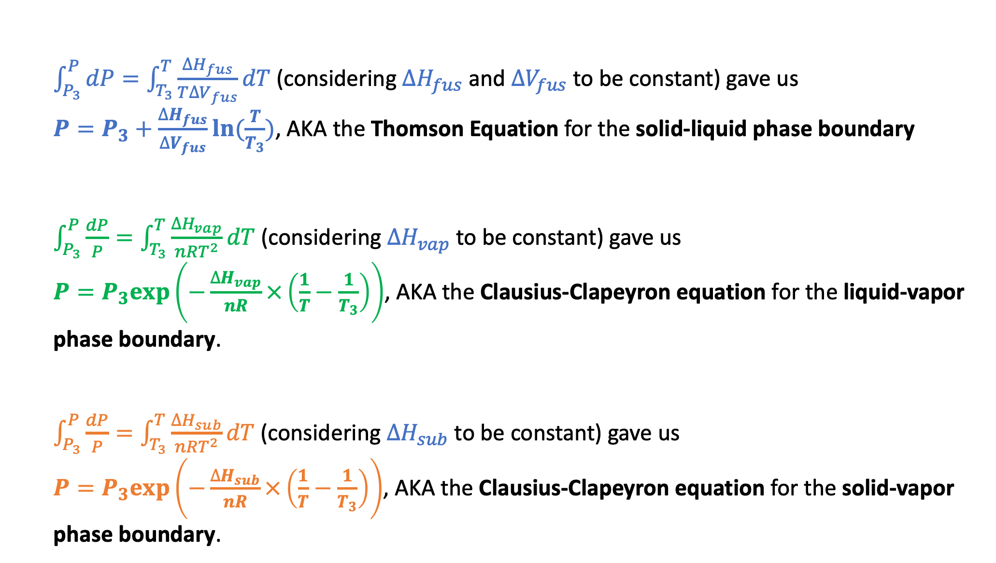
Recap of our results
$\int_{P_{3}}^{P}{dP}=\int_{T_{3}}^{T}{\frac{∆H_{fus}}{T∆V_{fus}}dT}$ (considering $∆H_{fus}$ and $∆V_{fus}$ to be constant) gave us
$P=P_{3}+\frac{∆H_{fus}}{∆V_{fus}}ln⁡(\frac{T}{T_{3}})$, AKA the Thomson Equation for the solid-liquid phase boundary
$\int_{P_{3}}^{P}{\frac{dP}{P}}=\int_{T_{3}}^{T}{\frac{∆H_{vap}}{nRT^{2}}dT}$ (considering $∆H_{vap}$ to be constant) gave us
$P=P_{3}exp⁡\left(−\frac{∆H_{vap}}{nR}×\left(\frac{1}{T}−\frac{1}{T_{3}}\right)\right)$, AKA the Clausius-Clapeyron equation for the liquid-vapor phase boundary.
$\int_{P_{3}}^{P}{\frac{dP}{P}}=\int_{T_{3}}^{T}{\frac{∆H_{sub}}{nRT^{2}}dT}$ (considering $∆H_{sub}$ to be constant) gave us
$P=P_{3}exp⁡\left(−\frac{∆H_{sub}}{nR}×\left(\frac{1}{T}−\frac{1}{T_{3}}\right)\right)$, AKA the Clausius-Clapeyron equation for the solid-vapor phase boundary.

Slide 2
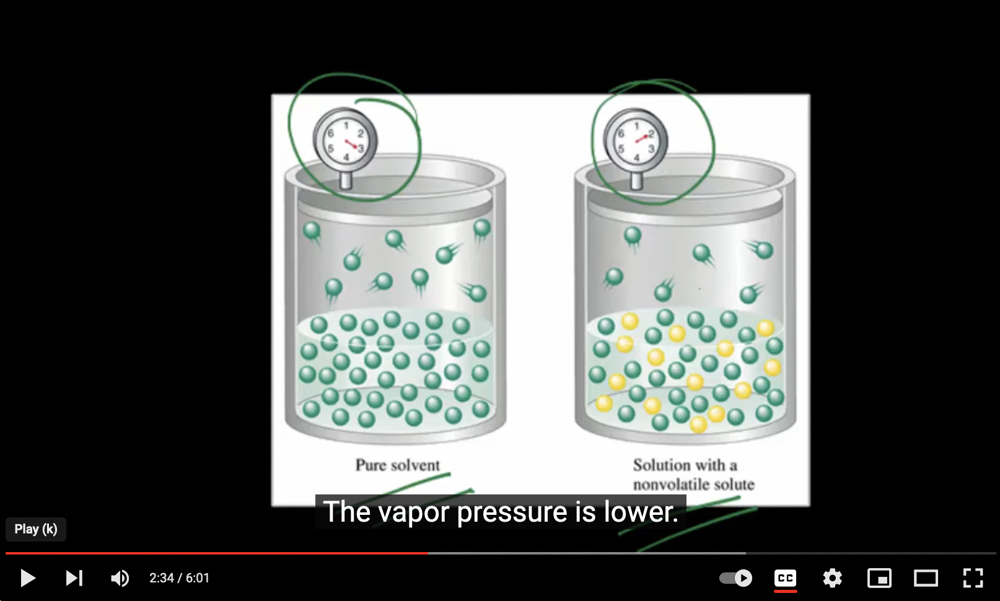
Next: when there’s solute …
https://youtu.be/jMj4txLGNG4

Slide 3

Our notation: $P_{A}^{∗}$ is the vapor pressure over pure solvent A, $P_{A}$ is when it’s a solution below
A(g)
A(g)
${P_{A}=P}_{A}^{∗}$
Equilibrium
Not in equilibrium
A
A
A
A
Add solute B
B
A
A
A
A
A
A
A
A
Solvent A with solute B
B
Pure solvent A
A
A
A
A
The vapor pressure of the gaseous form of a solvent in equilibrium with a solution ($P_{A}$) will be less than it would be above the pure solvent ($P_{A}^{∗}$).

Slide 4

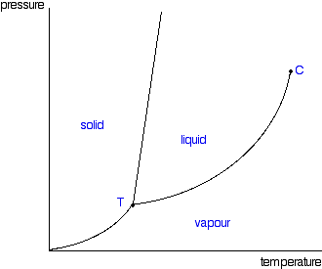



Our notation: $P_{A}^{∗}$ is the vapor pressure over pure solvent A, $P_{A}$ is when it’s a solution below
P
A(g)
${P_{A}<P}_{A}^{∗}$
New equilibrium
A
$$P_{A}^{∗}$$
B
A
A
A
A
Solvent A with solute B
B
$$P_{A}$$
A
A
T
The vapor pressure of the gaseous form of a solvent in equilibrium with a solution ($P_{A}$) will be less than it would be above the pure solvent ($P_{A}^{∗}$).

Slide 5

Raoult’s Law relates $P_{A}$ to $P_{A}^{∗}$
P
A(g)
${P_{A}=P}_{A}^{∗}χ_{A}$
New equilibrium
A
$$P_{A}^{∗}$$
B
A
A
A
A
Solvent A with solute B
B
$$P_{A}$$
A
A
T
Here, $χ_{A}$ is the mole fraction of solvent A in the solution,
$χ_{A}≡\frac{n_{A}}{n_{A}+n_{B}}$. A handy formula: $χ_{A}=\frac{1}{1+M_{A}b_{B}}$ where $b_{B}≡\frac{mol B}{kg A}$ is the solute’s molality.

Slide 6
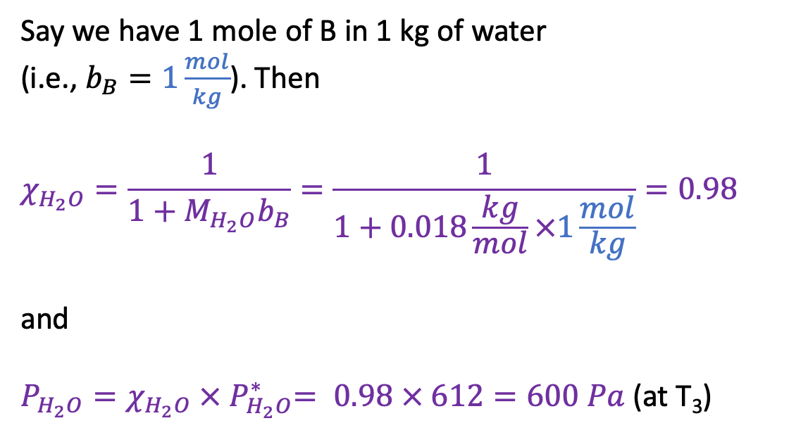
Example Raoult’s Law calculation
P
Say we have 1 mole of B in 1 kg of water
(i.e., $b_{B}=1\frac{mol}{kg}$). Then
$$χ_{H_{2}O}=\frac{1}{1+M_{H_{2}O}b_{B}}=\frac{1}{1+0.018\frac{kg}{mol}×1\frac{mol}{kg}}=0.98$$
and
$P_{H_{2}O}=χ_{H_{2}O} {× P}_{H_{2}O}^{∗}= 0.98 × 612=600 Pa$ (at T₃)
$$P_{A}^{∗}$$
612 Pa
$$P_{A}$$
600 Pa
T

Slide 7
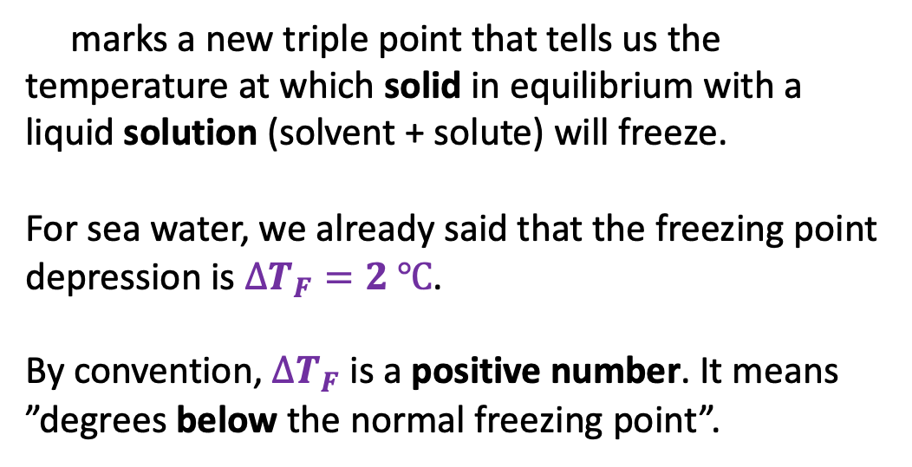

Raoult’s Law and freezing point depression
P
marks a new triple point that tells us the temperature at which solid in equilibrium with a liquid solution (solvent + solute) will freeze.
For sea water, we already said that the freezing point depression is $∆T_{F}=2 ℃$.
By convention, $∆T_{F}$ is a positive number. It means ”degrees below the normal freezing point”.
$$P_{A}^{∗}$$
$$P_{A}$$
$$∆T_{F}$$
T

Slide 8

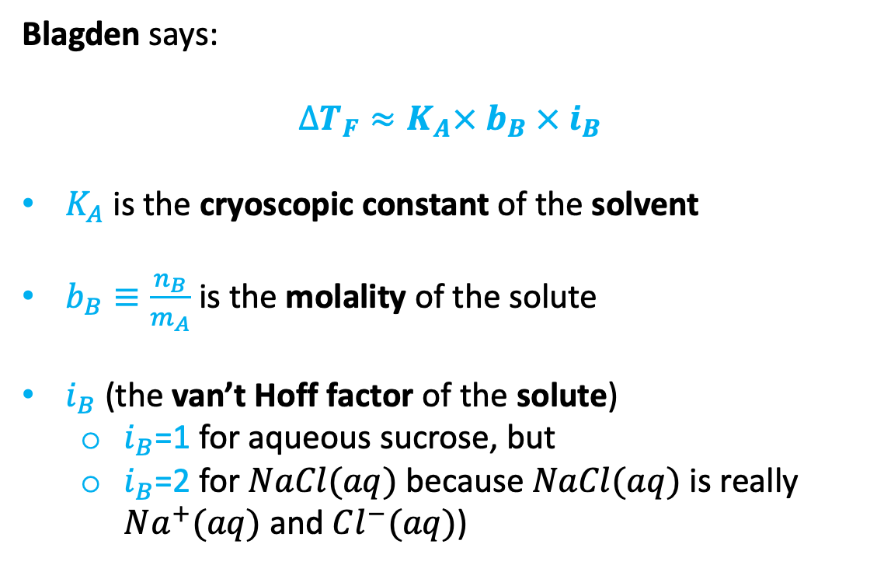


Blagden’s Law for freezing point depression
Blagden says:
$$∆T_{F}≈K_{A}× b_{B} × i_{B}$$
$K_{A}$ is the cryoscopic constant of the solvent
$b_{B}≡\frac{n_{B}}{m_{A}}$ is the molality of the solute
$i_{B}$ (the van’t Hoff factor of the solute)
$i_{B}$=1 for aqueous sucrose, but
$i_{B}$=2 for $NaCl(aq)$ because $NaCl(aq)$ is really $Na^{+}(aq)$ and $Cl^{−}(aq)$)
P
$$P_{A}^{∗}$$
$$P_{A}$$
$$∆T_{F}$$
T
Hypothesis: there’s a connection between Blagden and Raoult.
How to explore that hypothesis: use ${P_{A}=P}_{A}^{∗}χ_{A}$ to deduce $∆T_{F}≈K_{A}× b_{B} × i_{B}$.

